Slide 1
MongoDB - Aggregation

Slide 2
Aggregation Syntax
The aggregate command operates on a collection like the other Create, Read, Update, Delete (CRUD) commands,
use sample_mflix;
var pipeline = [] // The pipeline is an array of stages.
var options = {}
var cursor = db.movies.aggregate(pipeline, options);

Slide 3
Aggregation Syntax
There are two parameters used for aggregation. The pipeline parameter contains all the logic to find, sort, project, limit, transform, and aggregate our data.
The pipeline parameter itself is passed in as an array of JSON documents. You can think of this as a series of instructions to be sent to the database, and then the resulting data after the final stage is stored in a cursor to be returned to you.
Each stage in the pipeline is completed independently, one after another, until none are remaining.
The input to the first stage is the collection (movies in the preceding example), and the input into each subsequent stage is the output from the previous stage.
The second parameter is the options parameter. This is optional and allows you to specify the details of the configuration, such as how the aggregation should execute or some flags that are required during debugging and building your pipelines.

Slide 4
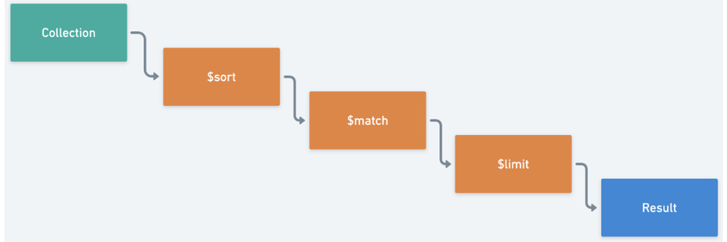
Pipeline
pipeline is referred to as an aggregation stage:

Slide 5
Example:
1. Match the theater collection to get a list of all theaters in the state of MN (Minnesota).
2. Project only the city in which the theater is located.
3. Sort the list by city name.
4. Limit the result to the first three theaters.
var pipeline = [
{ $match: { "location.address.state": "MN"} },
{ $project: { "location.address.city": 1 } },
{ $sort: { "location.address.city": 1 } },
{ $limit: 3 }
];
db.theaters.aggregate(pipeline).forEach(printjson);

Slide 6
Practice 1:
"Return the top three movies in the romance genre sorted by IMDb rating, and return only movies released before 2001.“
1. Translate your query into sequential stages that you can map to your aggregation stages: limit to three movies, match only romance movies, sort by IMDb rating, and match only movies released before 2001.
2. Simplify your stages wherever possible by merging duplicate stages. In this case, you can merge the two match stages: limit to three movies, sort by IMDb rating, and match romance movies released before 2001.
Order in pipeline matters!

Slide 7
$group stage
the $group stage allows you to group (or aggregate) documents based on a specific condition.
a $group stage accepts only an _id key, with the value being an expression. This expression defines the criteria by which the pipeline groups documents together. This value becomes the _id of the newly outputted document with one document generated for each unique _id that the $group stage creates.
var pipeline = [
{$group: {
_id: "$rated"
}}
];
db.movies.aggregate(pipeline).forEach(printjson);

Slide 8
Accumulator Expressions
The $group command can accept more than just one argument. It can also accept any number of additional arguments in the following format:
field: { accumulator: expression}
var pipeline = [
{$group: {
_id: "$rated",
"numTitles": { $sum: 1},
}}
];
db.movies.aggregate(pipeline).forEach(printjson);

Slide 9
Aggregate Simple Exercises
Find the top 5 movies with the highest Tomato rating.
Find the top 3 movies with the most awards won.
Count how many movies were released each year.
Count how many movies were released each year, only list years with more than 5 movies
Calculate the average Tomato rating of all movies.
Calculate the average runtime of movies for each year, sort by the average runtime
Identify the users who made the most comments.

Slide 10
Aggregate: $unwind
$unwind is a relatively simple stage. It deconstructs an array field from an input document to output a new document for each element in the array.
Example: List all genres and count how many times each genre appears across all movies.
db.movies.aggregate([
{ $unwind: "$genres" },
{ $group: { _id: "$genres", count: { $sum: 1 } } },
{ $sort: { count: -1 } }
]);

Slide 11
Aggregate Exercises: $unwind
Find the average length of movies produced in each country.
Determine the most frequently used language in the movies.

Slide 12
Aggregate: $lookup
$lookup can be used to join collections based on a “primary key” and a “foreign key”
Example: Count the number of comments each movie received.
db.movies.aggregate([
{ $lookup: { from: "comments", localField: "_id", foreignField: "movie_id", as: "comments" } },
{ $project: { title: 1, numberOfComments: { $size: "$comments" } } }
]);

Slide 13
Aggregate Exercises: $lookup
Show titles of movies along with the number of comments each received in year 2015
Retrieve the details of directors for each movie.
Find the age of the user who made each comment.
Find the total number of comments made by each user.

Slide 14
Practice 2:
"For only movies older than 2001, find the average and maximum popularity for each genre, sort the genres by popularity, and find the adjusted (with trailers) runtime of the longest movie in each genre."
1. Match movies that were released before 2001.
2. Group all movies by their first genre and accumulate the average and maximum IMDb ratings.
3. Sort by the average popularity of each genre.
4. Project the longest adjusted runtime of each genre.

Slide 15
Aggregate: Summary
SQL command | Aggregation framework operator
SELECT | $project
 | $group functions: $sum, $min, $avg, etc.
FROM | db.collectionName.aggregate(...)
JOIN | $unwind
WHERE | $match
GROUP BY | $group
HAVING | $match

